Slide 1
C Programming Beginner’s Guide
It's time to write your first C program.
Topics discussed in this section:
Structure of a C Program
Your First C Program
Comments
The Greeting Program

Slide 2
FIGURE 2-2 Structure of a C Program

Slide 3
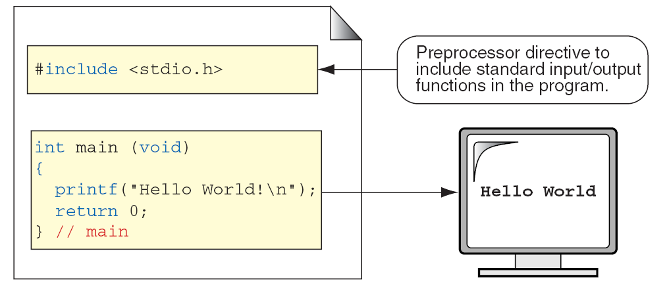
FIGURE 2-3 The Greeting Program

Slide 4
PROGRAM 2-1
The Greeting Program

Slide 5
FIGURE 2-4 Examples of Block Comments

Slide 6
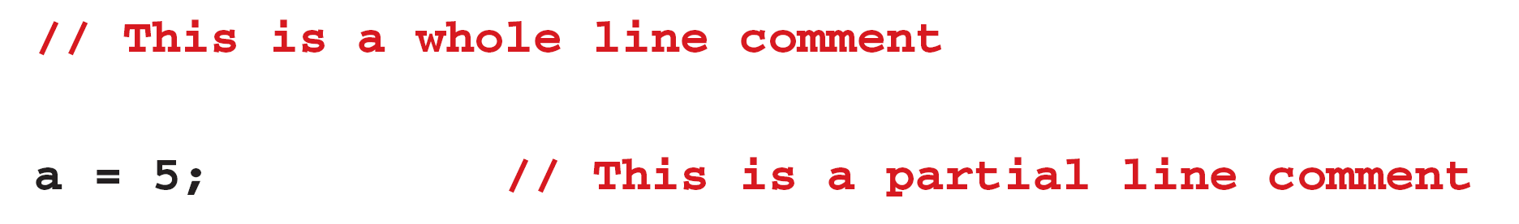
FIGURE 2-5 Examples of Line Comments

Slide 7
FIGURE 2-6 Nested Block Comments Are Invalid

Slide 8
2-3 Identifiers
One feature present in all computer languages is the identifier. Identifiers allow us to name data and other objects in the program. Each identified object in the computer is stored at a unique address.

Slide 9
Table 2-1
Rules for Identifiers

Slide 10
Note
An identifier must start with a letter or underscore: it may not have a space or a hyphen.

Slide 11
Note
C is a case-sensitive language.

Slide 12
Table 2-2
Examples of Valid and Invalid Names

Slide 13
2-4 Types
A type defines a set of values and a set of operations that can be applied on those values.
Topics discussed in this section:
Void Type
Integral Type
Floating-Point Types

Slide 14
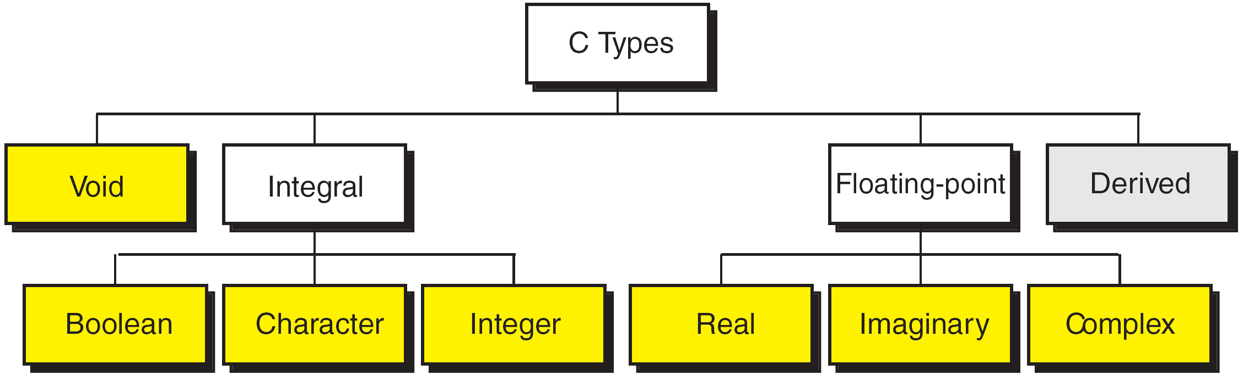
FIGURE 2-7 Data Types

Slide 15
FIGURE 2-8 Character Types
Notes:
wchar_t is a wide character: The increased datatype size allows for the use of larger coded character sets. Width is compiler specific (not portable).

Slide 16
FIGURE 2-9 Integer Types

Slide 17
Note
sizeof (short) ≤ sizeof (int) ≤ sizeof (long) ≤ sizeof (long long)

Slide 18
Table 2-3
Typical Integer Sizes and Values for Signed Integers

Slide 19
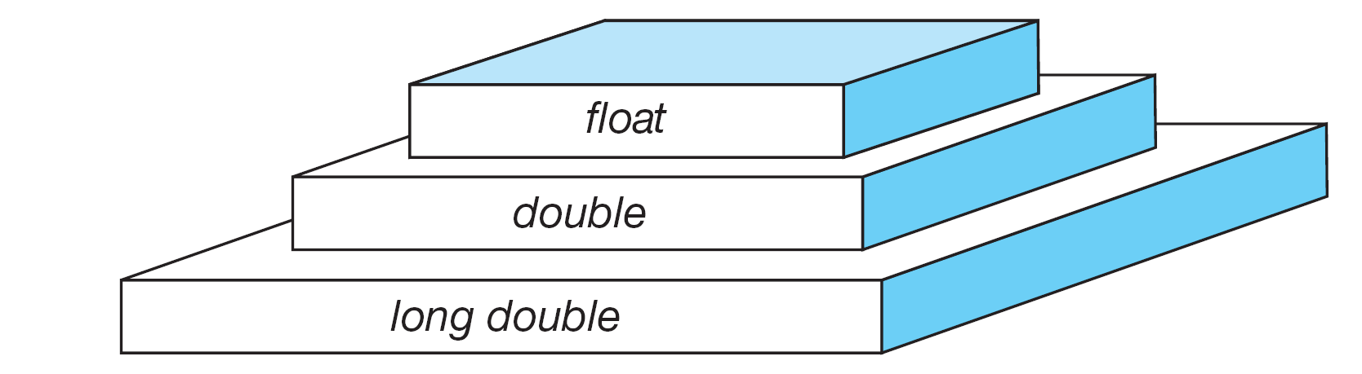
FIGURE 2-10 Floating-point Types

Slide 20
Note
sizeof (float) ≤ sizeof (double) ≤ sizeof (long double)

Slide 21
Table 2-4
Type Summary

Slide 22
2-5 Variables
Variables are named memory locations that have a type, such as integer or character, which is inherited from their type. The type determines the values that a variable may contain and the operations that may be used with its values.
Topics discussed in this section:
Variable Declaration
Variable Initialization

Slide 23
FIGURE 2-11 Variables

Slide 24
Table 2-5
Examples of Variable Declarations and Definitions

Slide 25
‘B’
FIGURE 2-12 Variable Initialization

Slide 26
Note
When a variable is defined, it is not initialized. We must initialize any variable requiring prescribed data when the function starts.

Slide 27
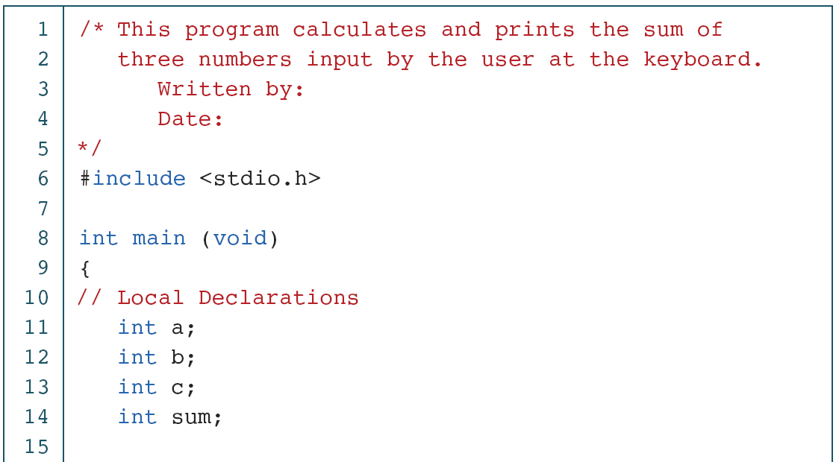
PROGRAM 2-2
Print Sum of Three Numbers

Slide 28
PROGRAM 2-2
Print Sum of Three Numbers (continued)

Slide 29
PROGRAM 2-2
Print Sum of Three Numbers (continued)

Slide 30
2-6 Constants
Constants are data values that cannot be changed during the execution of a program. Like variables, constants have a type. In this section, we discuss Boolean, character, integer, real, complex, and string constants.
Topics discussed in this section:
Constant Representation
Coding Constants

Slide 31
Note
A character constant is enclosed in single quotes.

Slide 32
Table 2-6
Symbolic Names for Control Characters

Slide 33
Table 2-7
Examples of Integer Constants

Slide 34
Table 2-8
Examples of Real Constants

Slide 35
FIGURE 2-13 Some Strings

Slide 36
FIGURE 2-14 Null Characters and Null Strings

Slide 37
Note
Use single quotes for character constants. Use double quotes for string constants.

Slide 38
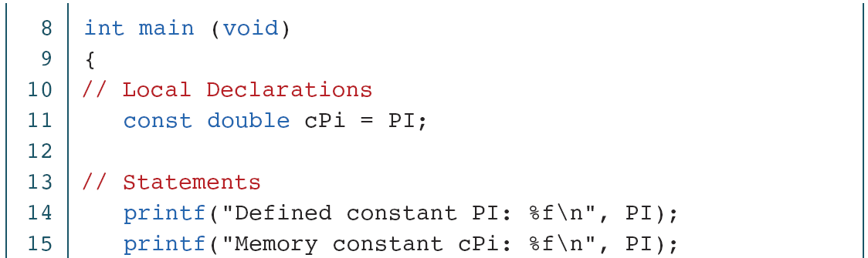
PROGRAM 2-3
Memory Constants

Slide 39
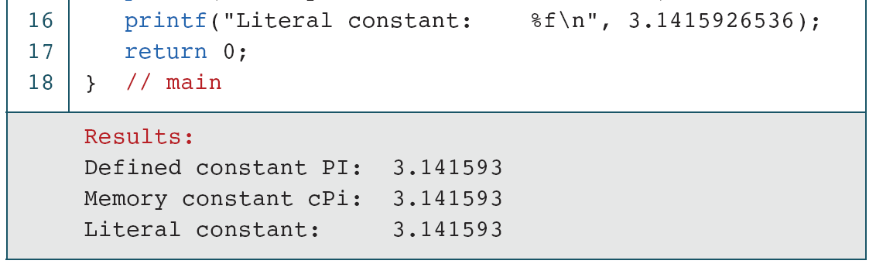
PROGRAM 2-3
Memory Constants (continued)

